Slide 1


Slide 2
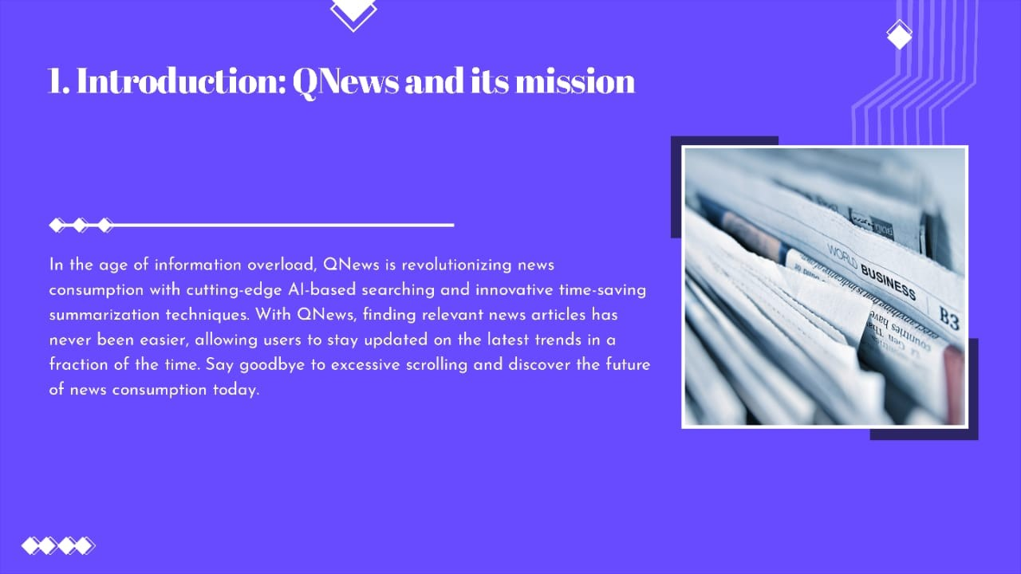

Slide 3
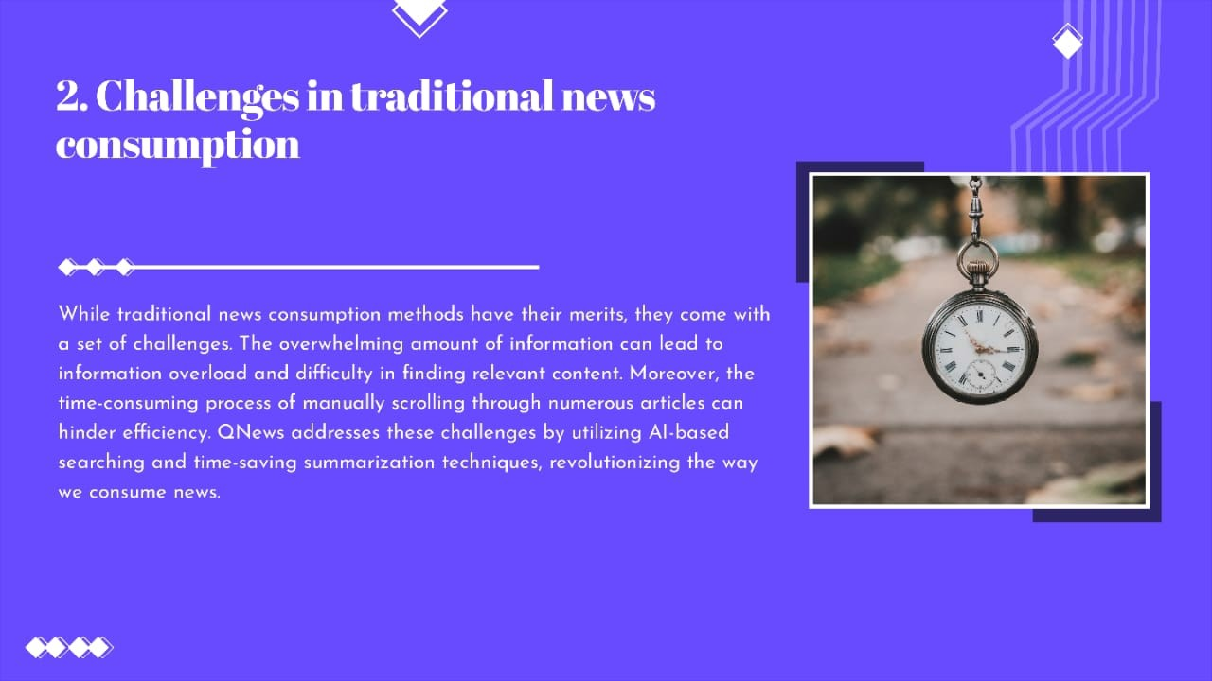

Slide 4
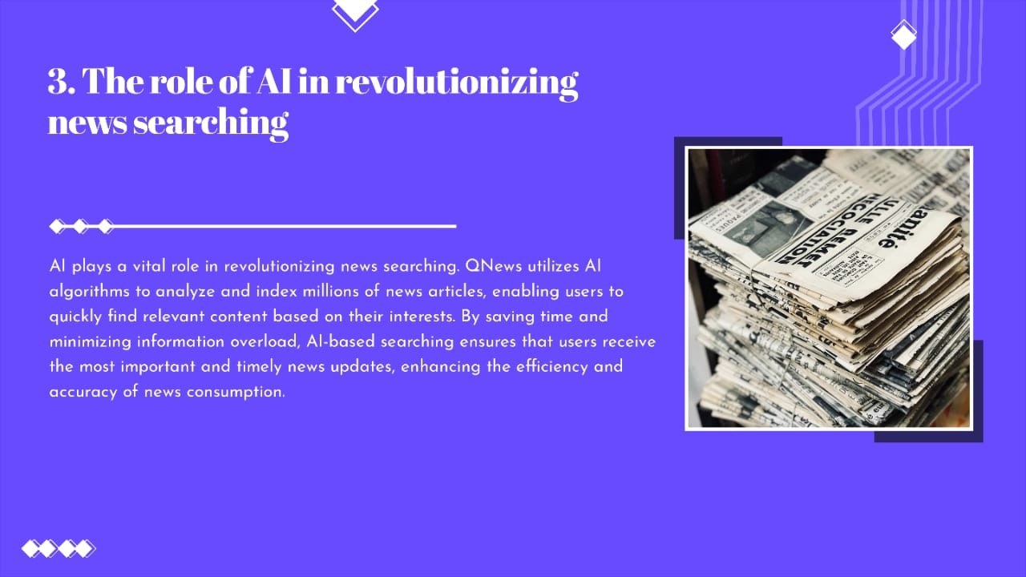

Slide 5
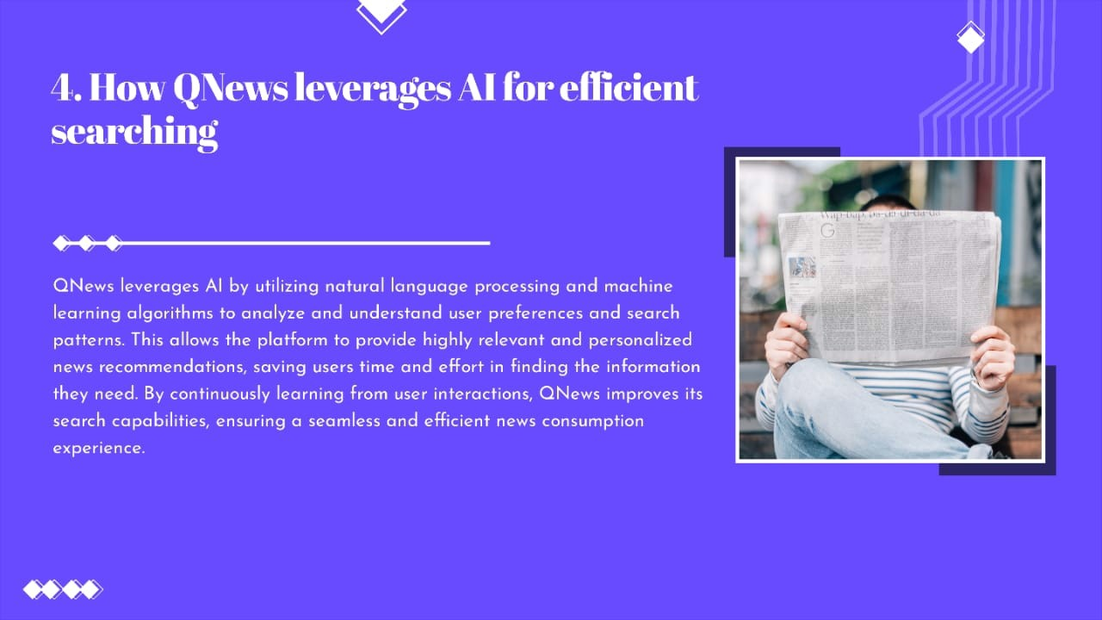

Slide 6
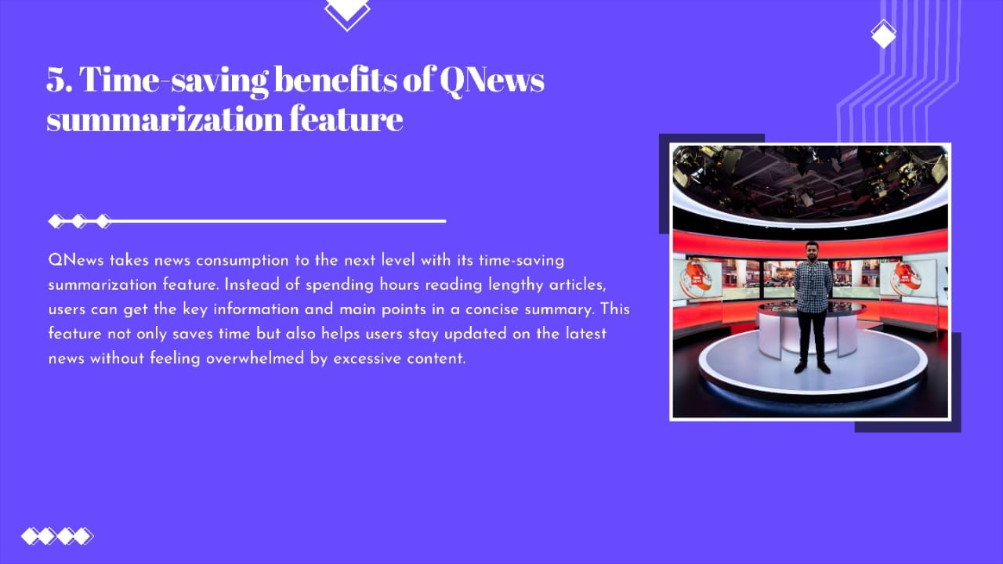

Slide 7
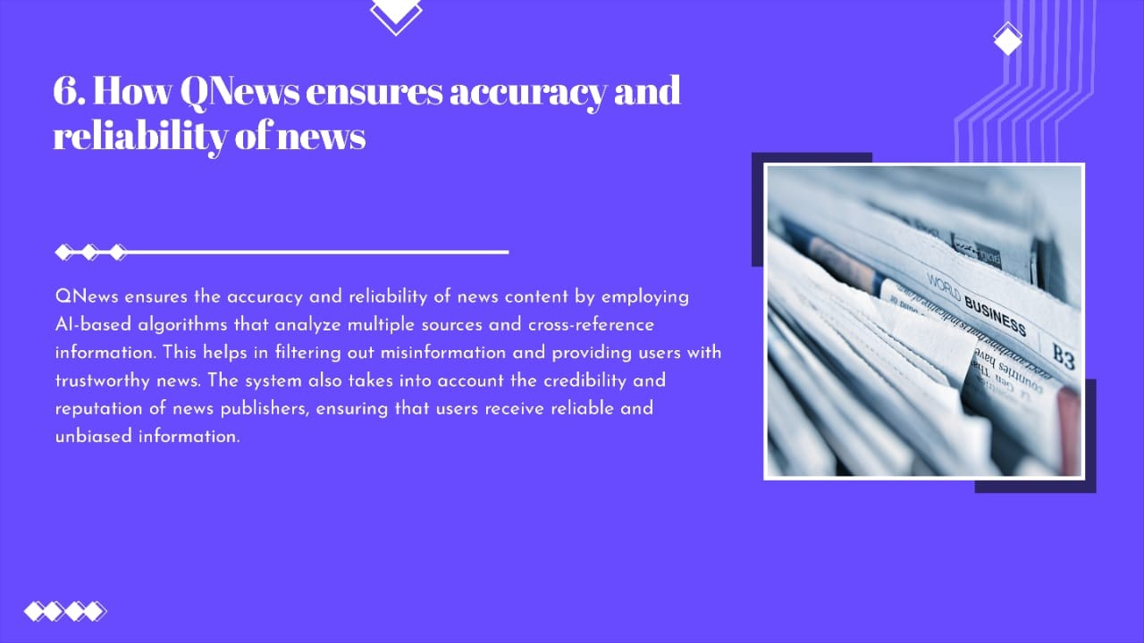

Slide 8
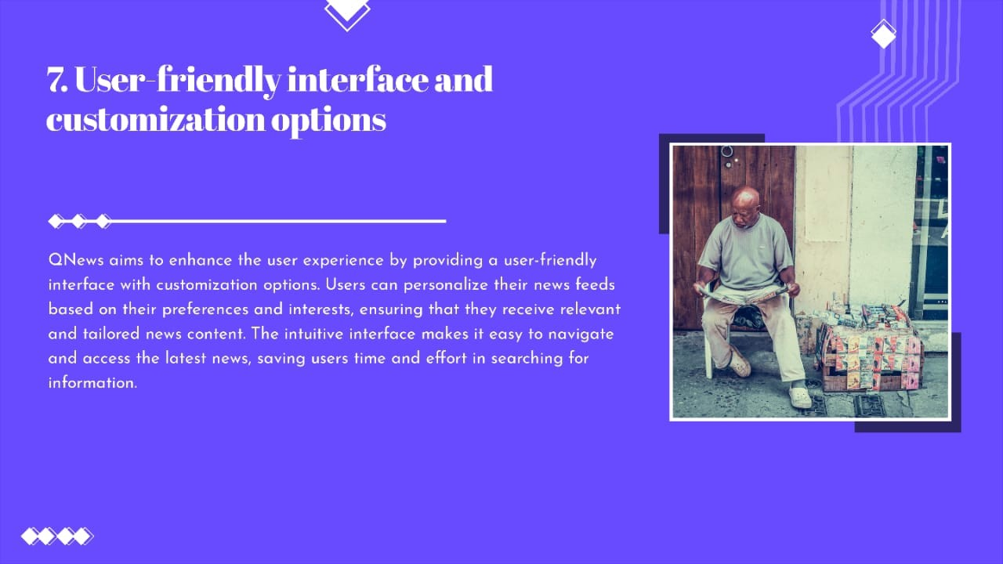

Slide 9
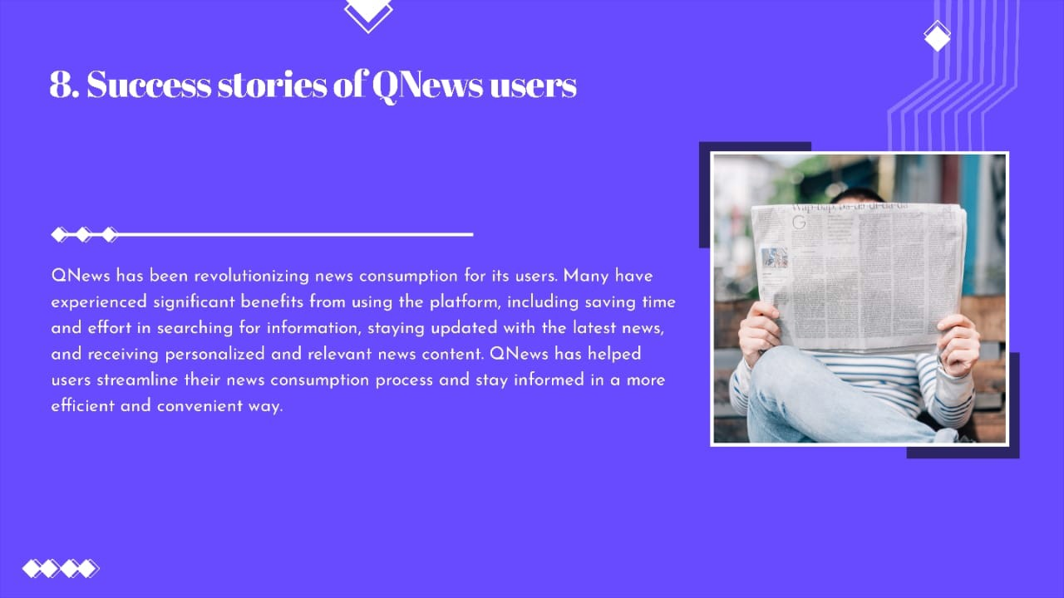

Slide 10
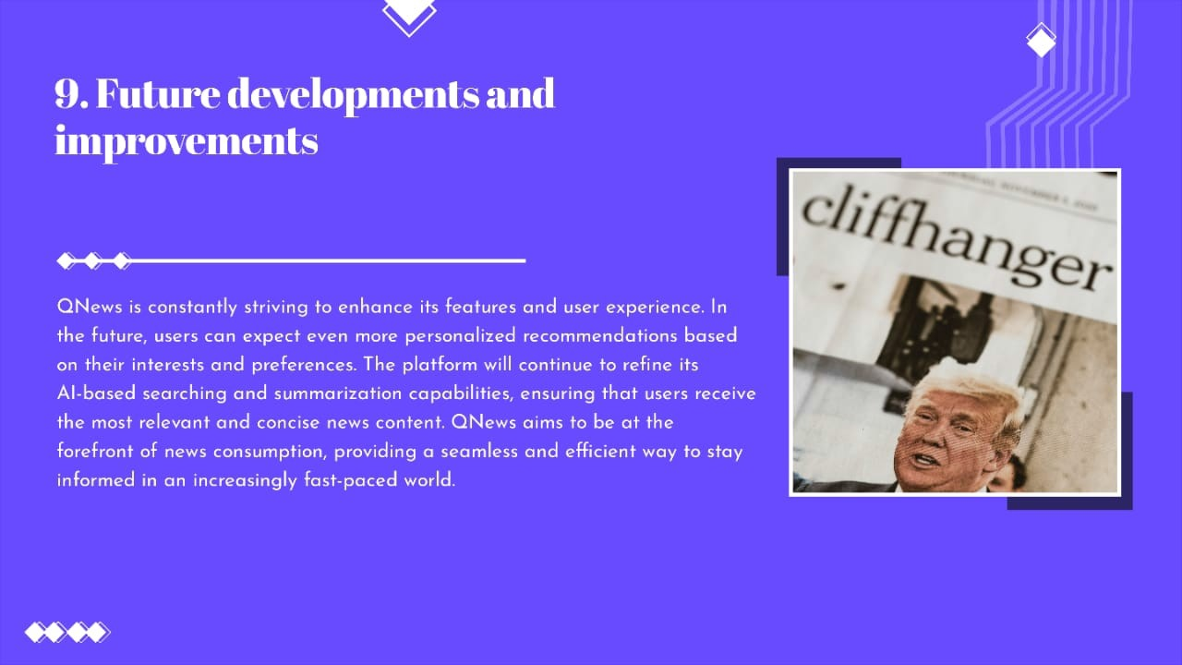

Slide 11
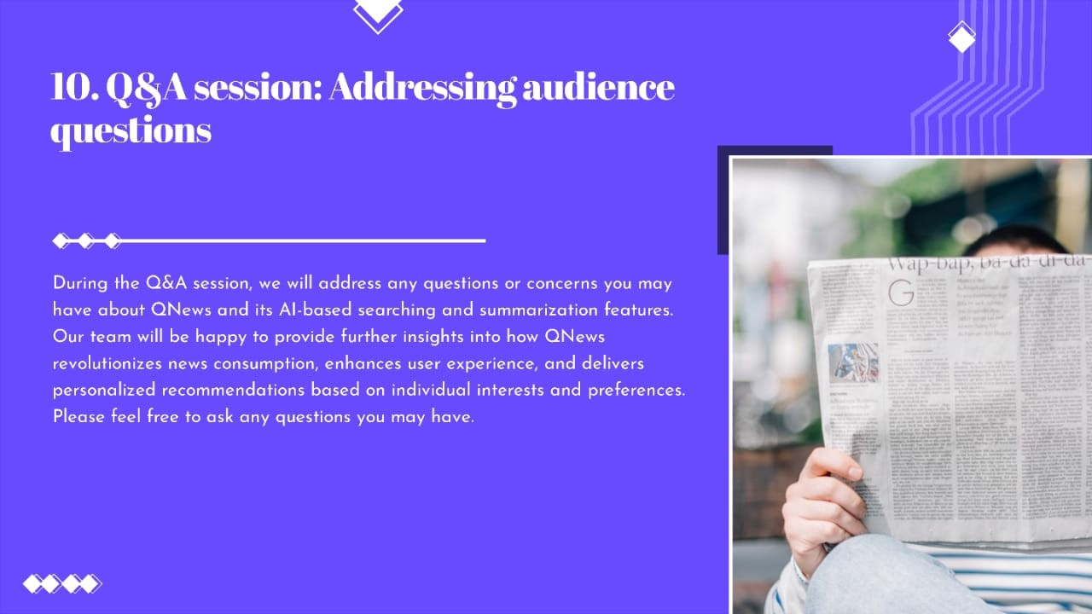

Slide 12
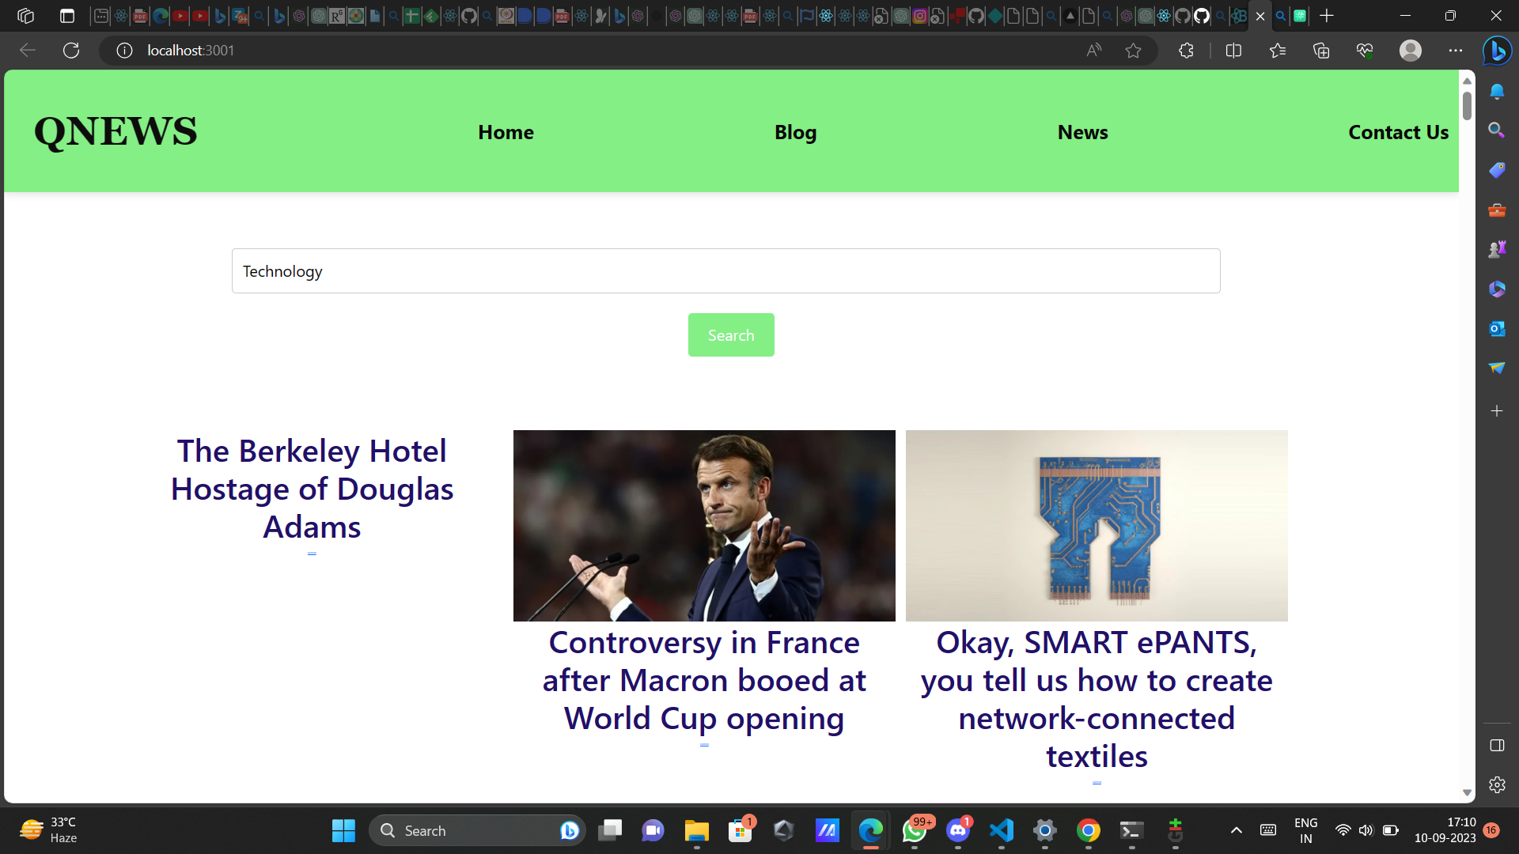

Slide 13
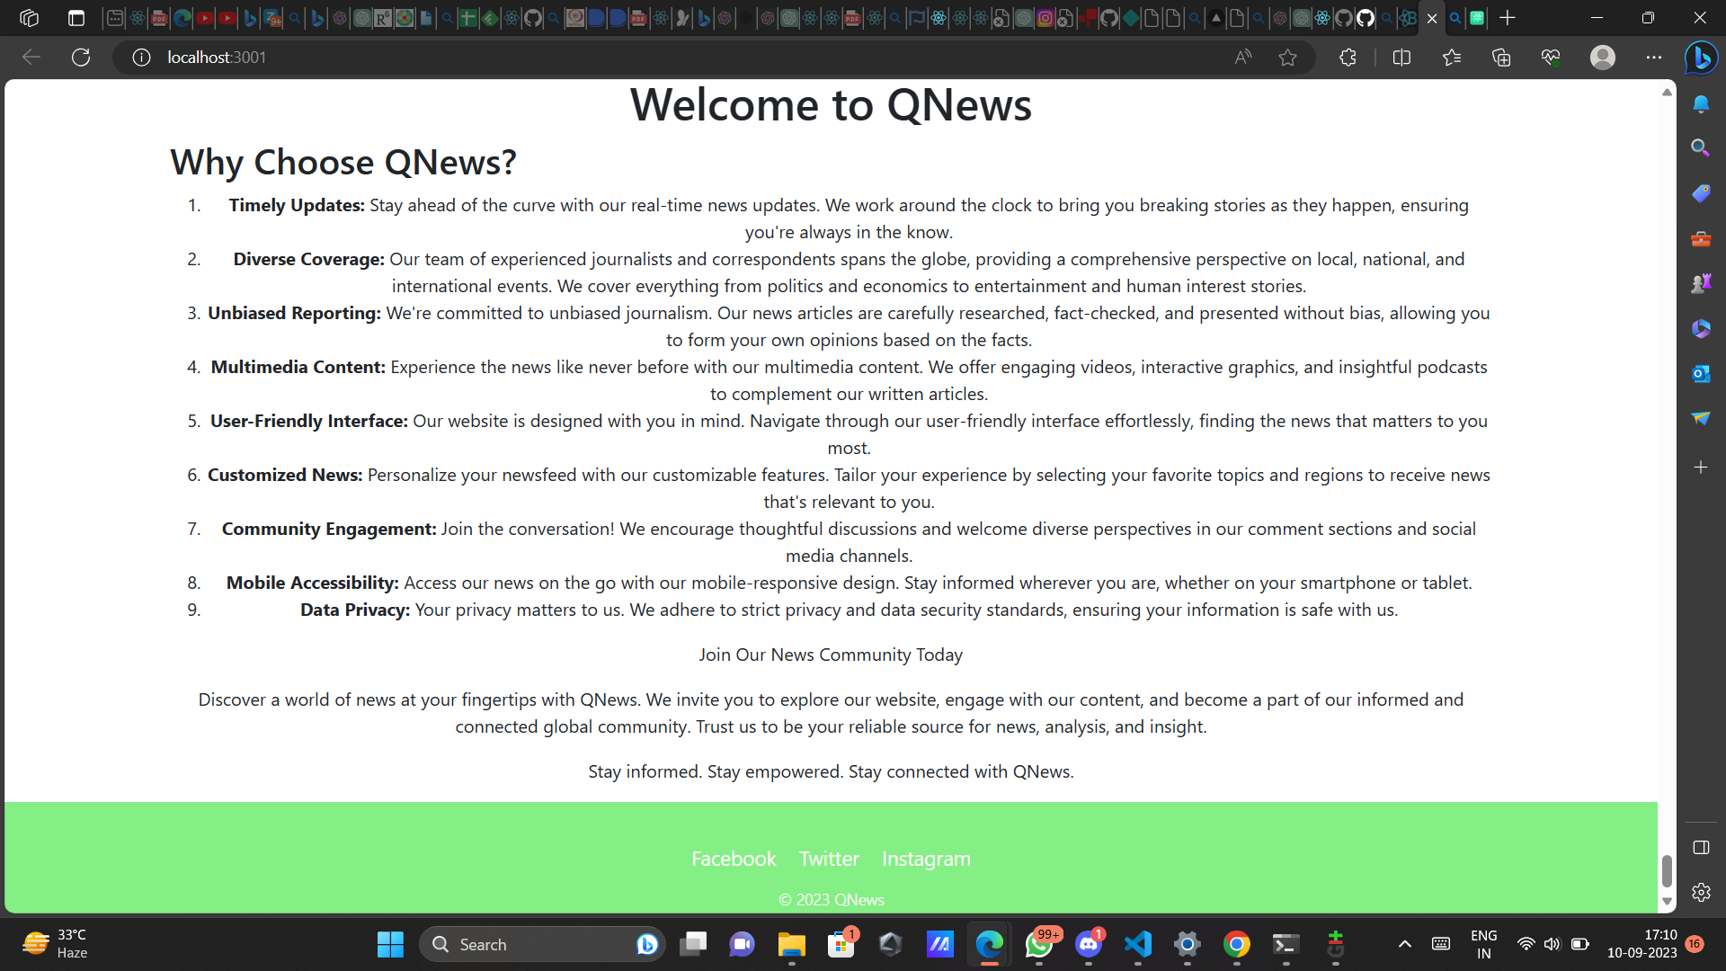

Slide 14
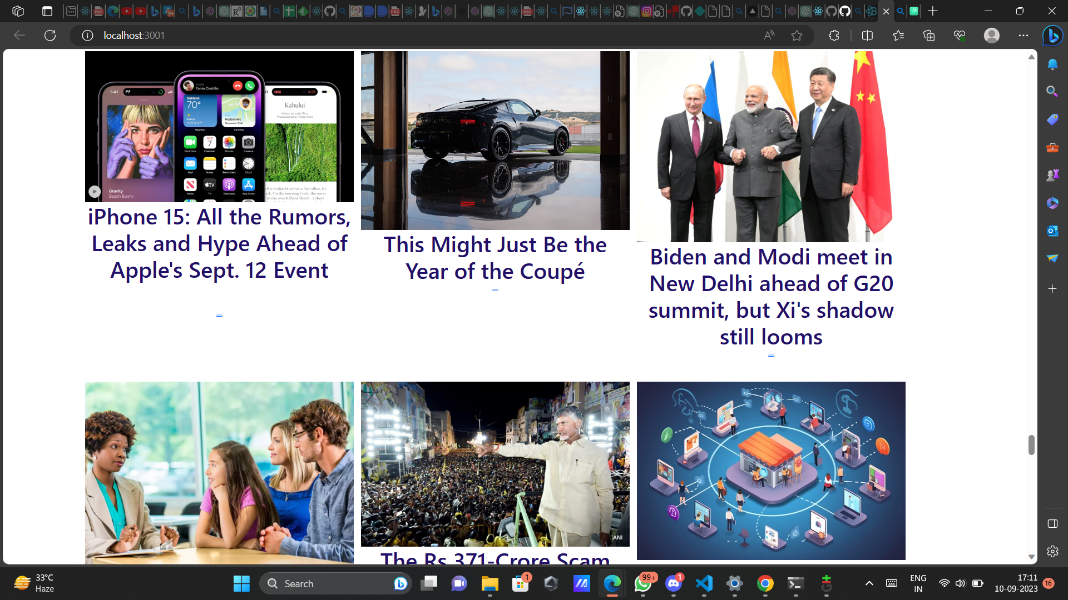

Slide 15
Insight on How QNews Feed Saves Time and Keeps Users Informed with Swift Searching Technique:
QuikNews Feed revolutionizes the way users consume news by harnessing the power of AI. Here's a glimpse of how it helps users save time while staying updated with current affairs:
🕒 Time-Efficient Summaries: Traditional news reading can be time-consuming. QuickNews Feed's AI-generated summaries condense lengthy articles into concise 200-word snippets. Users get the most crucial information in seconds, allowing them to stay informed even during short breaks.
🔍 Personalized Content: By using keywords, users access news tailored to their interests. No more sifting through irrelevant stories. AI algorithms understand user preferences, ensuring each news piece aligns with their chosen topics.
📚 Effortless Deep Dives: For those who want to delve deeper, QuickNews Feed provides full article access. With a single click, users can explore the entire story without the need to search multiple sources.

Slide 16
Conclusion

